Slide 1
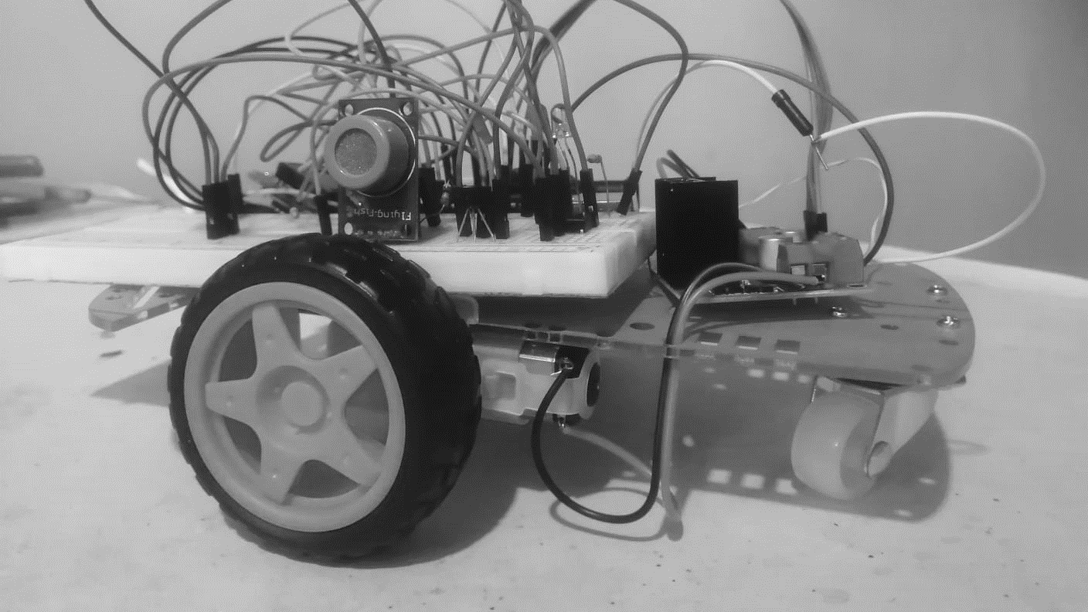
BLUETOOTH CONNECTED ROBOT WITH FIRE AND HAZARDOUS GAS DETECTION

Slide 2


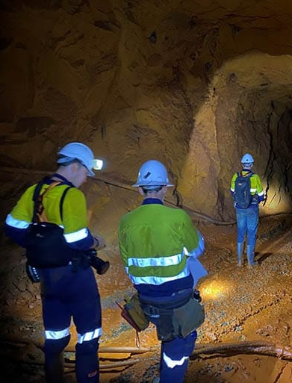
PROBLEM STATEMENT
Due to the increasing temperature and polluted air in working places like,
in underground mining operation side especially in coal mining,
Chemical plants operations
Waste treatment and recycling operations
there are so many health issues.
These health issues can lead to death too because of difficultness in breathing.

Slide 3
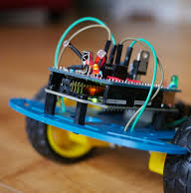

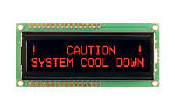
SOLUTION
Using an AVR microcontroller based combustible and hazardous gas and temperature detecting sensor to detect the hazardous gas and checking whether the ambient temperature is in limit or not
Achieving it with the help of a car kit which can roam around the surrounding with the aid of Bluetooth control.
If the surrounding is in danger, alerting the surrounding using buzzer, indicating using LED lights and displaying through LCD display.

Slide 4


SCOPE
OBJECTIVE
To alert the workers when the situation is in danger.
To prevent fire accidents.
Identifying a risky environment using temperature and gas sensors and providing signals to prevent the problem.

Slide 5
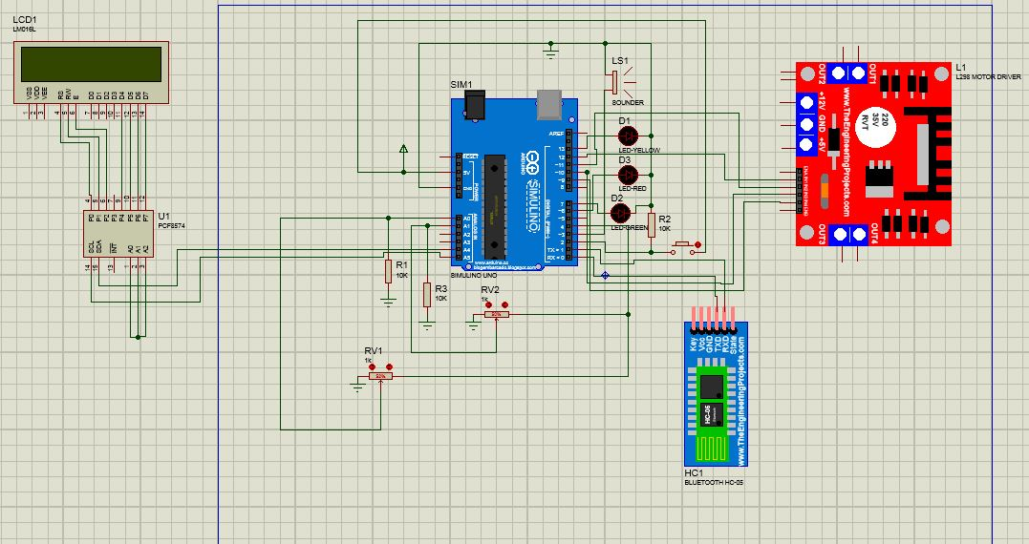

DETAILED ARCHITECTURE

Slide 6
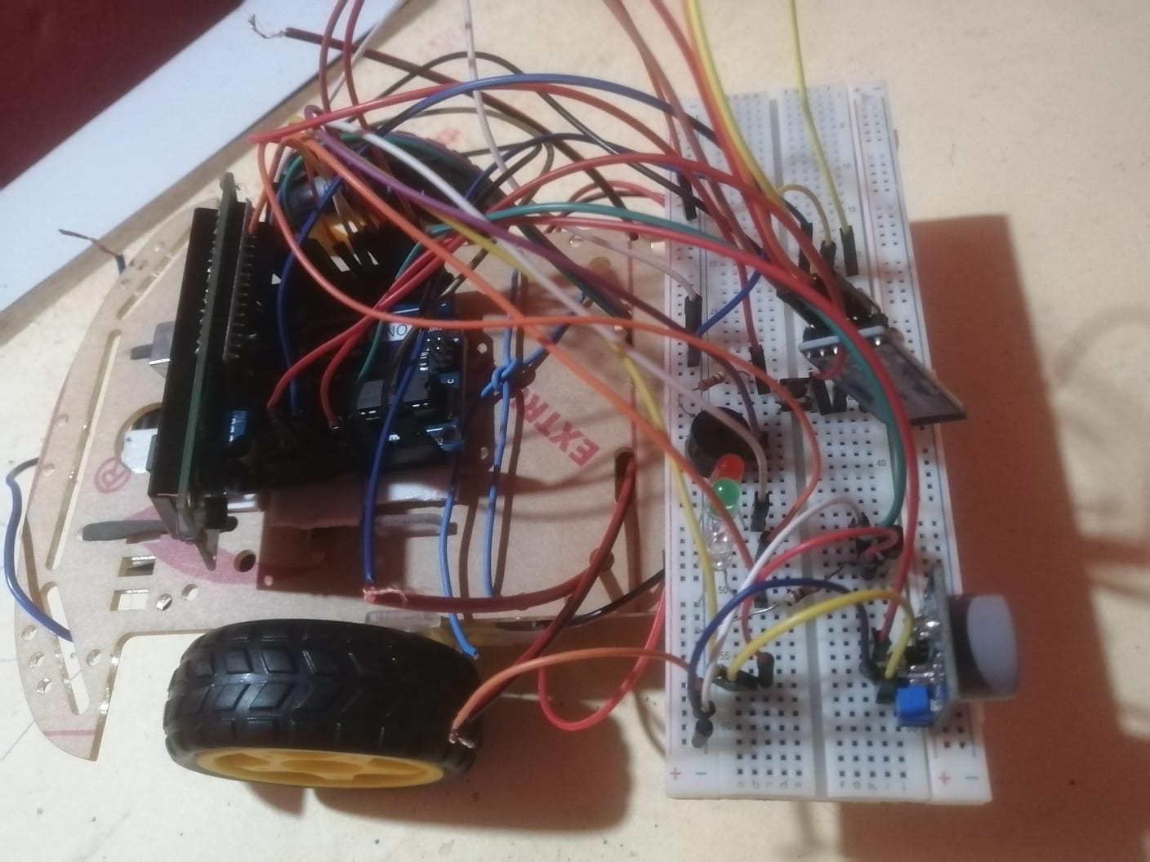
COMPLETE DESIGN
PUSH BUTTON
LCD DISPLAY
BLUETOOTH MODULE
MOTOR CONTROLLER
BUZZER
LEDs
LM 35 TEMPERATURE SENSOR
2 WD CAR KIT
MQ7 GAS SENSOR

Slide 7
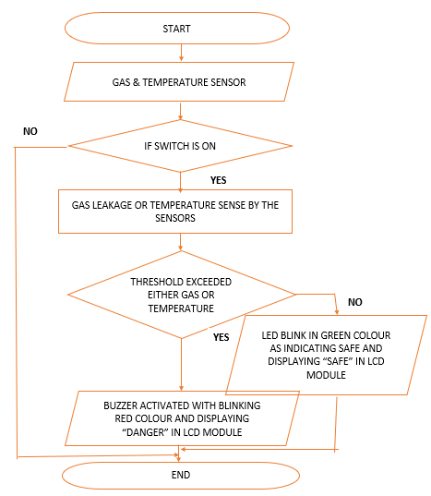
FLOW CHART

Slide 8
FINAL PRODUCT COST
Components | Quantity | Cost (Rs)
2WD smart car kit | 1 | 1,380
3.7V battery | 2 | 1,000
LM 35 temperature sensor | 1 | 250
MQ-7 carbon monoxide sensor | 1 | 480
Bluetooth module | 1 | 510
LCD display | 1 | 420
I2C module | 1 | 250
Motor controller | 1 | 700
Other power component |  | 1,500
Total |  | 6,490

Slide 9
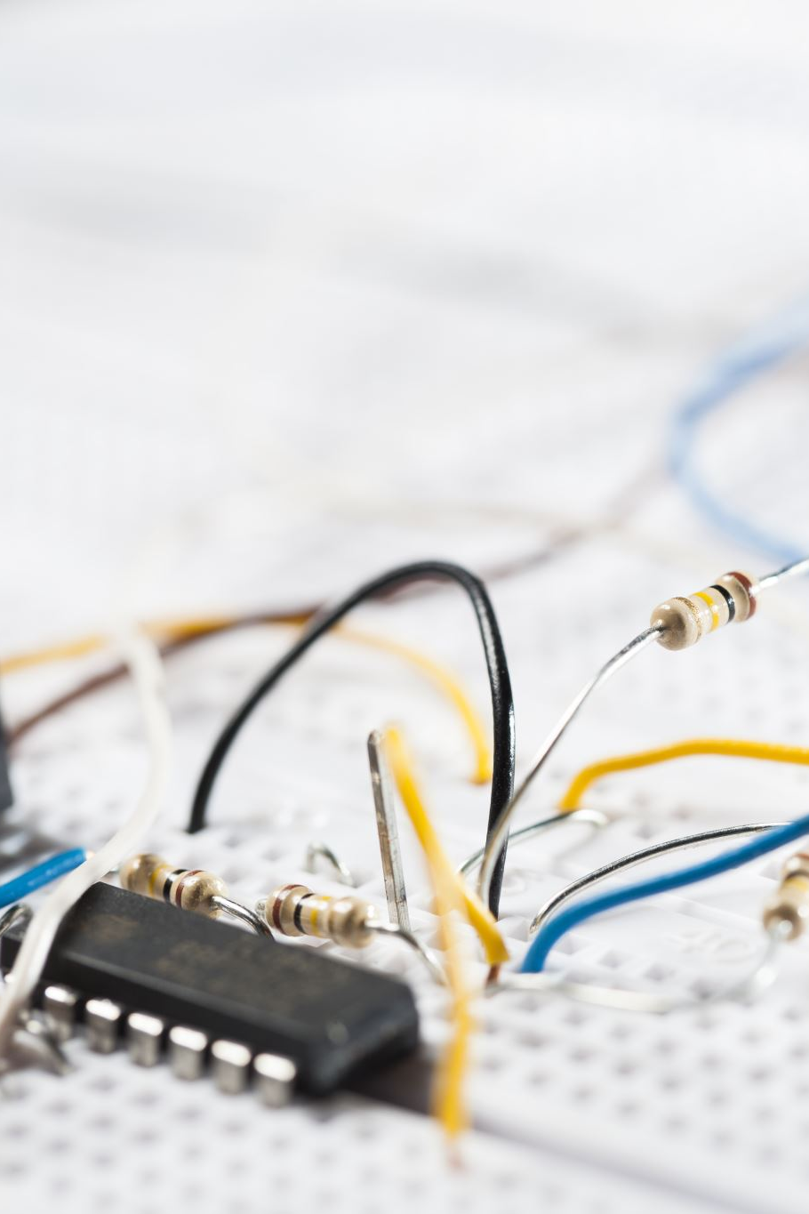
PROBLEMS
Calibrating the sensors.
Cost of the components.
Errors in the module.
Coordinating the jumper wires in the design.

Slide 10
THANK YOU!

